Slide 1
Angular Templates

Slide 2
What is Template?
template is a part of HTML.
Each Angular template in your application is a chunk of HTML to be included as part of the page displayed by the browser.
An Angular HTML template renders a view, or user interface, in the browser like regular HTML, but with much more functionality.

Slide 3
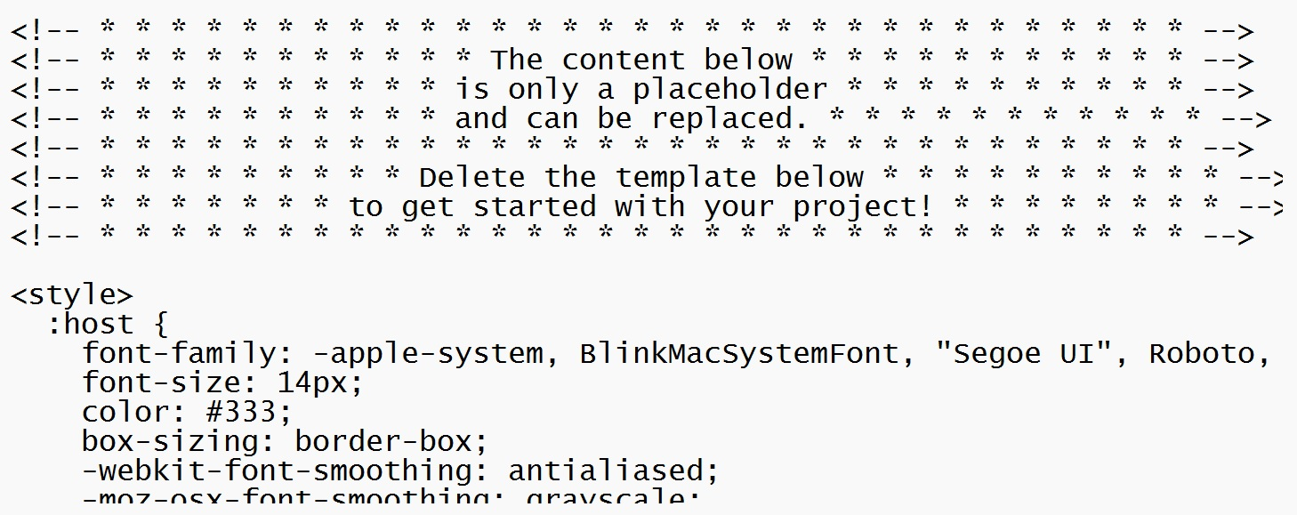
App.component.html

Slide 4
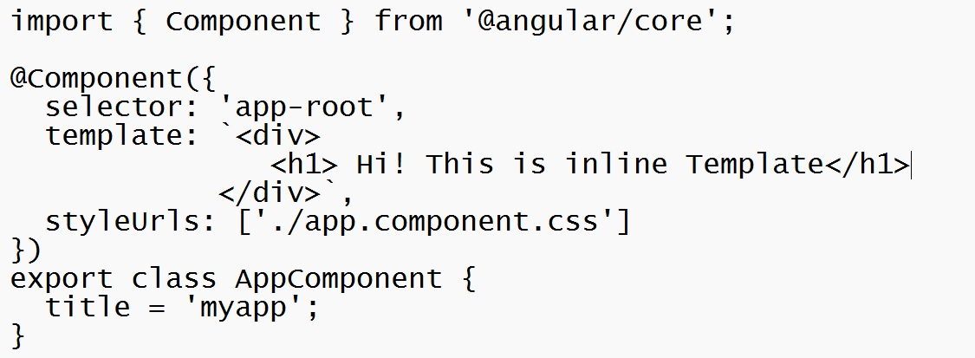
Types of templates
Inline : The template can be defined in app.componet.ts itself. No additional file required

Slide 5
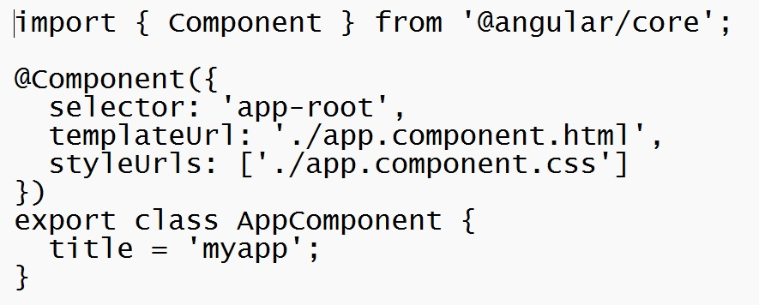
Types of templates
External Template: A separate file is created used for template.
External Template path

Slide 6
Functions of Template
Interpolation-How to Use Interpolation and Expressions in HTML.
Template statement-Respond to events in your template.
Binding Syntax- Use binding to coordinate values in your application.
Property binding - Sets the properties of target elements or directive @Input() decorators.
Attribute, class, and style binding- Set the values of attributes, classes, and styles.
Event binding- listen for events and your HTML.
Two-way binding- Share data between a class and its template.
Built-in directives- listen to and modify the behaviour and layout of HTML.
Template reference variable- Use a special variable to refer to a DOM element within a template.
Input and output- parent context and child instructions or components share data.
Template expression operators- learn about the pipe operators, |, and protect against null or undefined values in your HTML.

Slide 7
Data Binding
Data binding deals with how to bind your data from component to HTML DOM elements (Templates).
We can easily interact with application without worrying about how to insert your data.

Slide 8
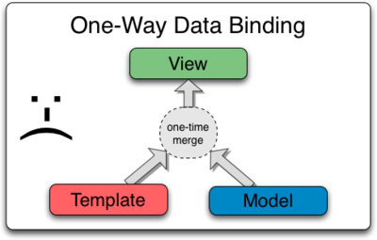
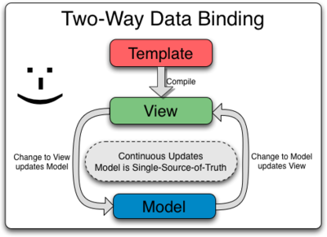
Data Binding Types
One-way Binding:
- Interpolation
- Property Binding
- Attribute Binding
- Style Binding
- Class Binding
- Event Binding
Two-way Binding:

Slide 9
Property Binding
Property binding is a one-way mechanism that lets you set the property of a view element.
It involves updating the value of a property in the component and binding it to an element in the view template. Property binding uses the [] syntax for data binding.

Slide 10
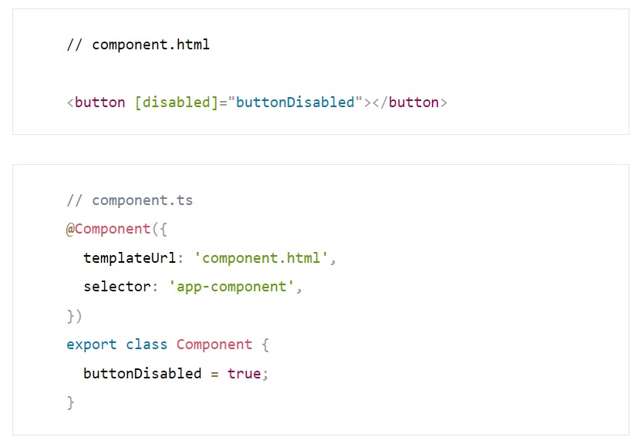
Property Binding

Slide 11
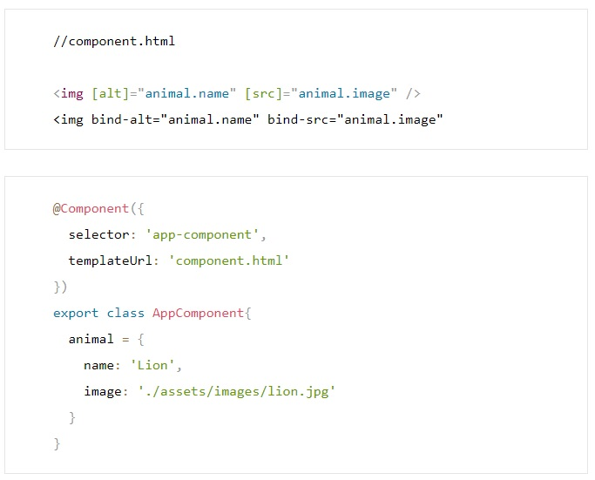
Property Binding
Using []
The code snippet binds data to the alt and src
properties of the img
element. Once the page rendering is complete, the browser will display the image and the resulting alt attribute.
Preceded by “bind-”

Slide 12
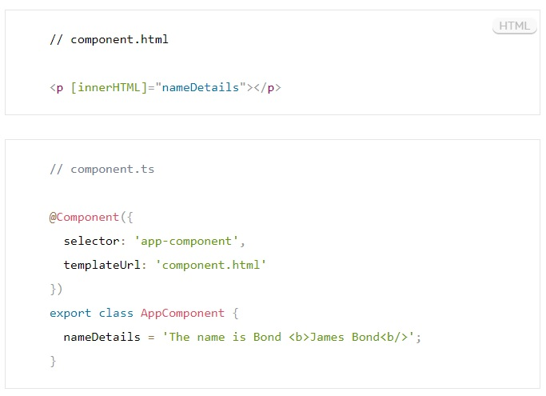
Property Binding
To render HTML using property binding, we can use the innerHTML property.
This property takes the assigned value of the attribute and displays it as the text content of the tag.
When rendered, Angular parses the b tag, and the text rendered within it is bold rather than rendering it as a normal string.
We can use any TAG except script TAG

Slide 13

Property Binding
If the script tag was set to the nameDetails value, it would render the element’s text content as a string rather than parsing it as an element. If the example below is attempted, the expression within the <script> tag will not be processed but rendered as a string:

Slide 14
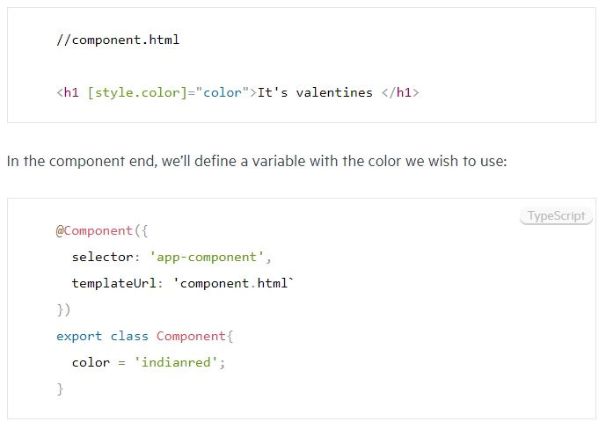
Style Binding
Style component property is being set

Slide 15
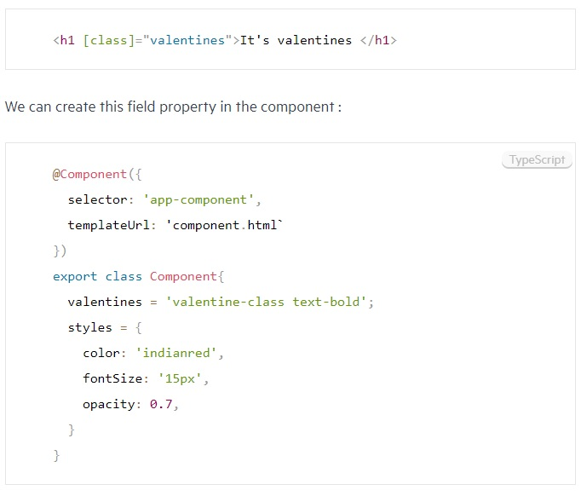
Class Binding

Slide 16
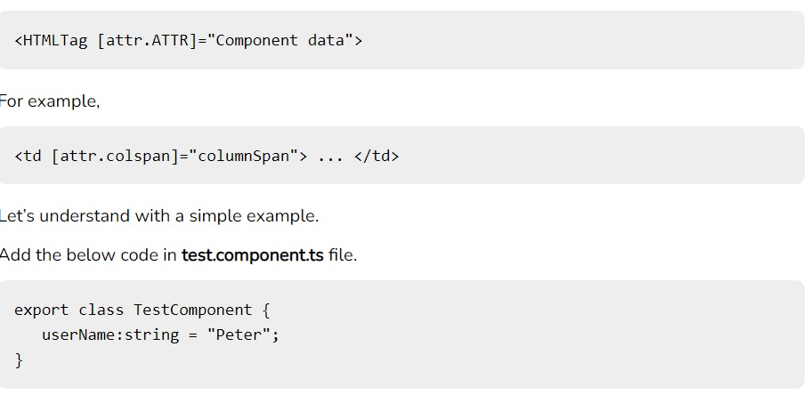
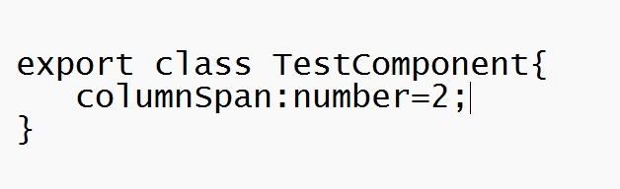
Attribute Binding

Slide 17
Interpolation
In the technique, text representing variables in components are placed in between double curly braces in the template.
Angular finds the variable matching the text in the component and replaces the text with the value assigned to the variable.
Numbers, strings, etc. can be used directly between the curly braces.

Slide 18
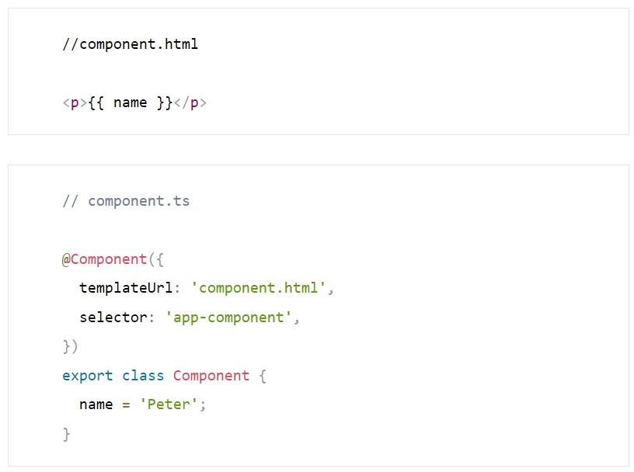
Interpolation

Slide 19
Event Binding
This data binding type is when information flows from the view to the component when an event is triggered.
The view sends the data from an event like the click of a button to be used to update the component.
It is the exact opposite of property binding, where the data goes from the component to the view.

Slide 20
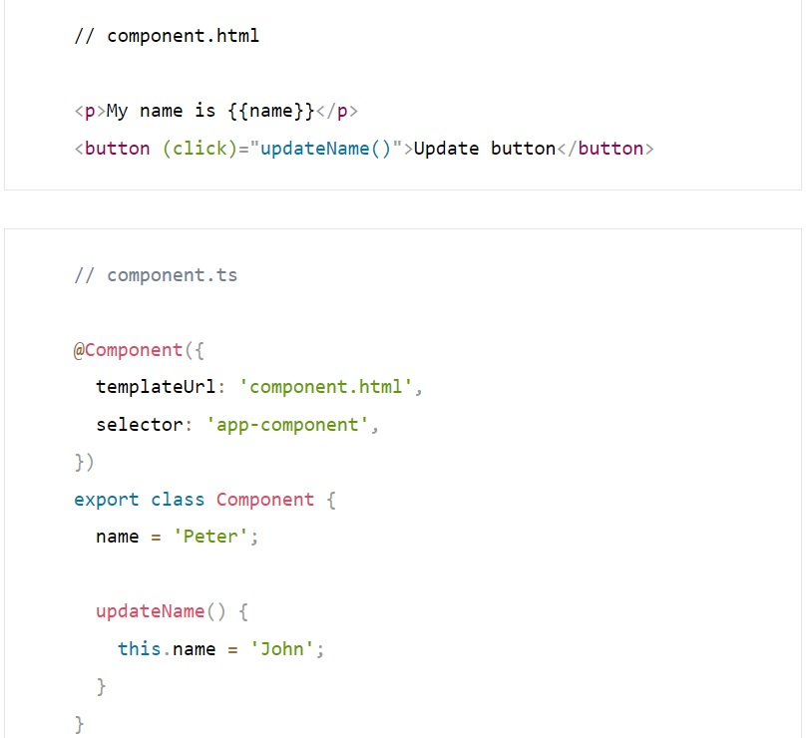
Event Binding

Slide 21
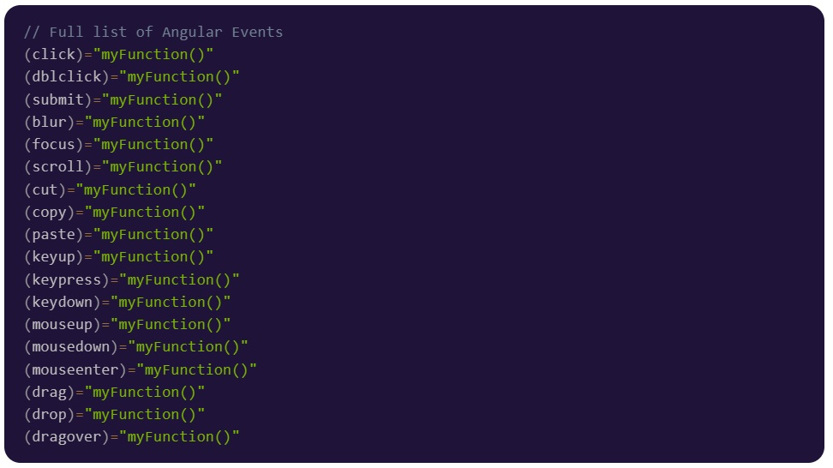
Event Binding

Slide 22
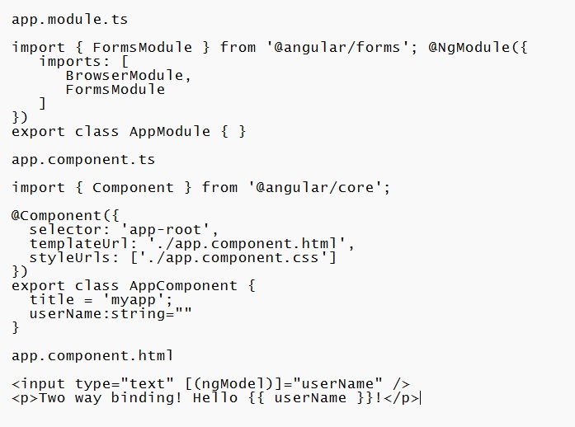
Two-way Data Binding

